Slide 1
OPTIMIZING CUSTOMER EXPERIENCES WITH PERSONALITY INSIGHTS AND SEGMENTATION
PRESENTED BY: INDU SRI GAMIDI

Slide 2
PROBLEM STATEMENT
Customers behave differently across the customer journey (awareness, purchase, post-purchase).
A one-size-fits-all approach leads to poor customer experiences.
Personalized approaches can improve retention, loyalty, and customer lifetime value (CLV).

Slide 3
PROJECT GOALS
1.Data science to analyze customer behavior.
2.Predict key customer outcomes.
3.Provide actionable insights through interactive visualizations.

Slide 4
Key Objectives
Data Acquisition & Preparation – Ensure accurate analysis.
Customer Segmentation – Group customers for targeted strategies.
Exploratory Data Analysis – Identify important patterns.
Predictive Modeling – Forecast customer behavior.
Interactive Visualization – Create Power BI dashboards.
Insight Generation & Reporting – Provide strategic recommendations.
Integration & Deployment – Implement insights into business.
Performance Monitoring – Maintain model accuracy over time.

Slide 5
DATASET DESCRIPTION
This dataset contains 2,240 entries and 29 columns, representing customer data from a marketing campaign. It includes demographic details, purchasing behaviors, and responses to marketing efforts.
Key Columns:
Customer Demographics:
ID: Unique customer identifier.
Year_Birth: Year of birth.Education: Level of education (Graduation, PhD, etc.).
Marital_Status: Relationship status (Single, Married, Together, etc.).
Income: Household income.
Kidhome: Number of small children in the household.
Teenhome: Number of teenagers in the household.
Dt_Customer: Date when the customer was enrolled.
2. Purchase Behavior:
Recency: Number of days since last purchase.
MntWines, MntFruits, MntMeatProducts, MntFishProducts, MntSweetProducts, MntGoldProds: Money spent on different product categories.
NumDealsPurchases: Number of purchases using discounts.
NumWebPurchases, NumCatalogPurchases, NumStorePurchases: Purchases made through different channels.NumWebVisitsMonth: Number of website visits in the last month.
3. Marketing Campaign Responses:
AcceptedCmp1 to AcceptedCmp5: Whether the customer accepted past campaigns.
Response: If the customer accepted the most recent campaign.
Complain: Whether the customer filed a complaint.Z_CostContact, Z_Revenue: Standardized cost and revenue variables.

Slide 6
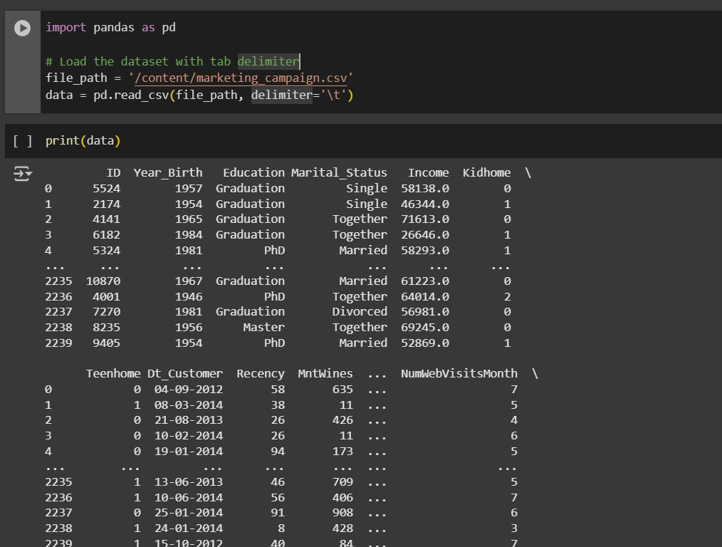
Step : 1 - imports the pandas library and loads a CSV file (marketing_campaign.csv) using a tab (\t) delimiter into a DataFrame named data.

Slide 7
step 2:
This code visualizes missing values in the dataset using a heatmap.
It uses sns.heatmap() from Seaborn, where yellow spots indicate missing values, and
plt.show() displays the plot.
3. Income has 24 missing values

Slide 8
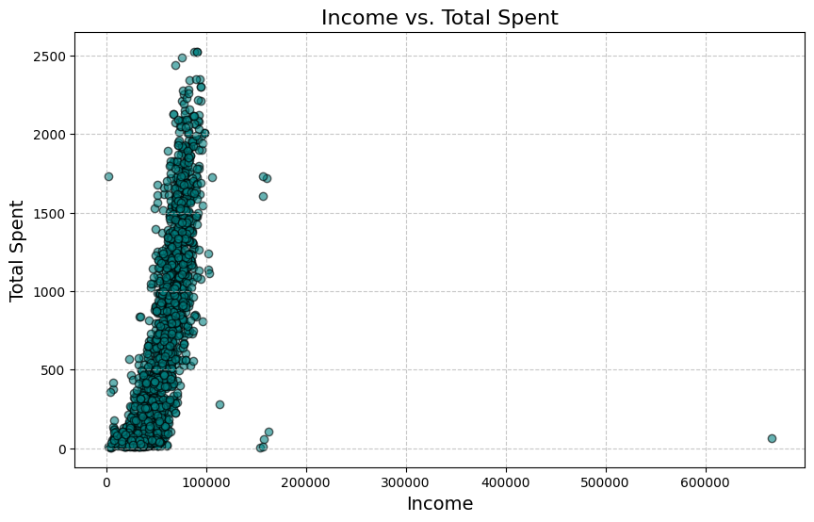
EDA:
EDA :
This scatter plot visualizes Income vs. Total Spent by customers.
Most data points are clustered around lower income levels (under 100,000).
A general positive trend suggests that higher income individuals tend to spend more.
A few extreme outliers exist, particularly one customer with an income above 600,000 but very low spending.
The density of points at lower income levels suggests a majority of customers fall in this range.

Slide 9
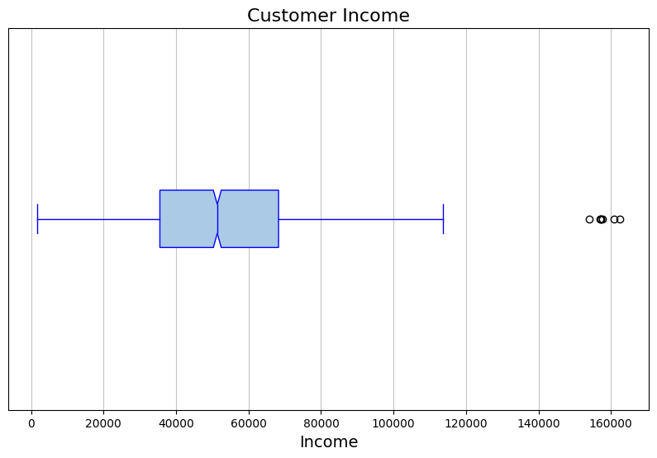
This is a box plot of customer income. Here’s what you can observe:
The box represents the interquartile range (IQR), showing the middle 50% of the data.
The median is the line inside the box.
The whiskers extend to the minimum and maximum values within 1.5 times the IQR.
The outliers (black circles) are incomes that fall beyond the whiskers, indicating unusually high values.

Slide 10
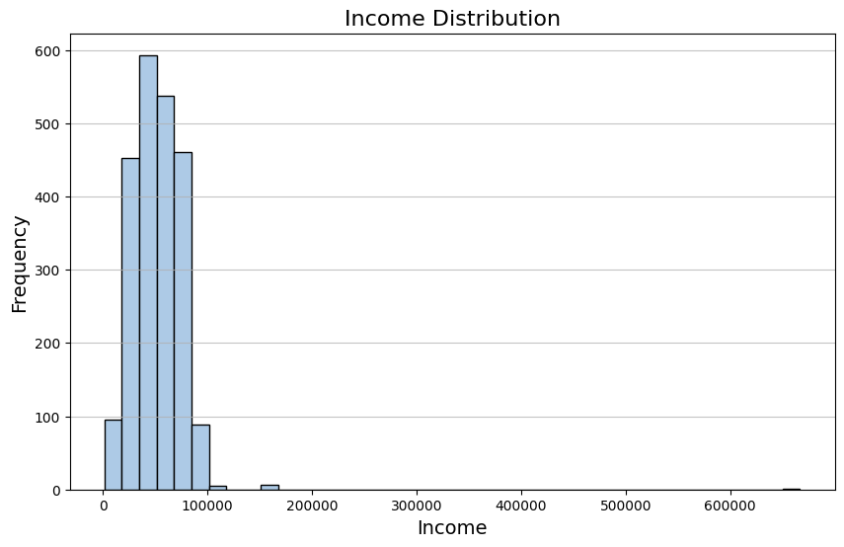
This is a histogram showing the Income Distribution of customers. Here’s what it indicates:
Most of the income values are concentrated in the lower range (under 100,000).
There are a few extreme outliers with significantly high income (above 200,000).
The distribution appears right-skewed, meaning most customers have lower incomes, while a few have very high incomes.

Slide 11
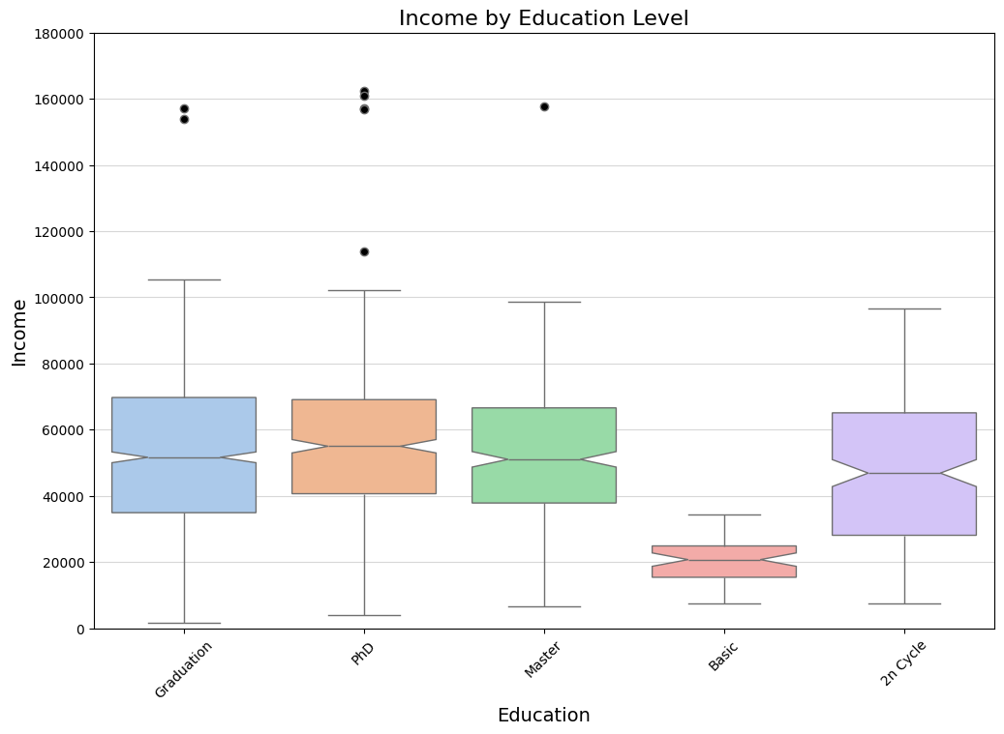
Box plot :
X-axis (Education Level):
The different education levels include Graduation, PhD, Master, Basic, and 2n Cycle.
Y-axis (Income):
Represents the annual income of customers.
Box Plot Interpretation:
The box represents the interquartile range (IQR), showing the middle 50% of incomes for each education level.
The horizontal line inside the box represents the median income.
The whiskers extend to the minimum and maximum values within 1.5 times the IQR.
The black dots above the whiskers are outliers, indicating extreme income values.
Result Analysis:
Higher education levels (Graduation, PhD, Master, and 2n Cycle) generally correlate with higher median incomes.
Basic education level has the lowest income distribution and a much smaller range.
Income distribution is similar for Graduation, PhD, Master,
and 2n Cycle, but slight variations exist in medians and
outliers.
Outliers in higher education groups indicate some
Individuals have exceptionally high incomes.

Slide 12
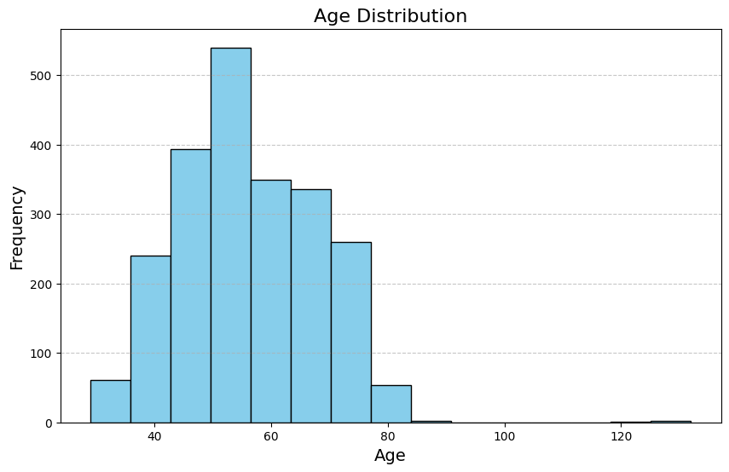
This histogram represents the Age
Distribution of customers from the dataset.
X-axis (Age):
Represents the age of customers, calculated from the Year_Birth column.
The values range approximately from 30 to 130, but extreme values beyond 100 are likely outliers.
Y-axis (Frequency):
Represents the number of customers falling within each age group.
Distribution Pattern:
The majority of customers are between 40 and 70 years old, with the highest concentration around the 50s.

Slide 13
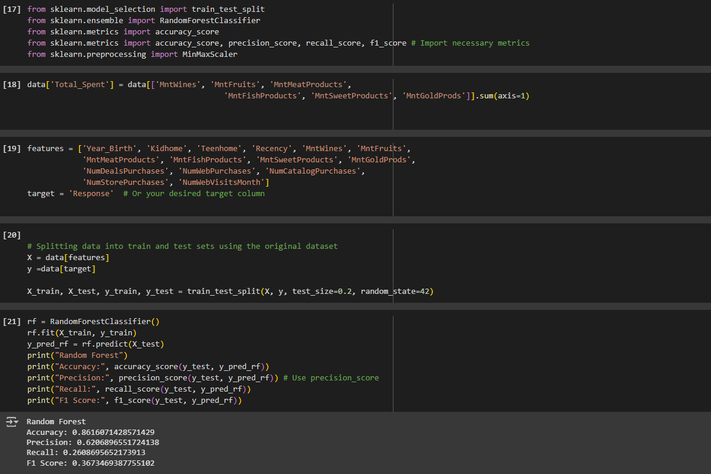
RANDOM FOREST –
1.Calculateed Total Spending: Sums the values from several columns and assigns the result to a new column named 'Total_Spent’.
2.Split Data: Divides the data into training and testing sets, with 20% of the data allocated for testing.
3. Train the Model: Creates a RandomForestClassifier model with 100 estimators (trees) and trains it using the training data.
4. Make Predictions: Uses the trained model to predict the target variable for the test data.
5. Evaluate Accuracy: Calculates the accuracy score by comparing the predicted values with the actual values in the test set. The accuracy is then printed to the console, formatted to two decimal places. The model accuracy is 0.85.

Slide 14
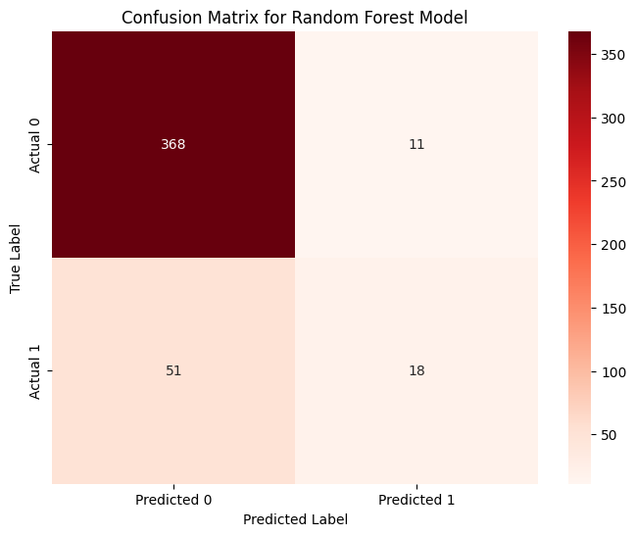
Based on the confusion matrix for the Random Forest model, the model's performance can be evaluated as follows:
True Positives (TP): 368 (Correctly predicted Actual 0)
True Negatives (TN): 51 (Correctly predicted Actual 1)
False Positives (FP): 11 (Incorrectly predicted Actual 0 as Actual 1)
False Negatives (FN): 18 (Incorrectly predicted Actual 1 as Actual 0)

Slide 15
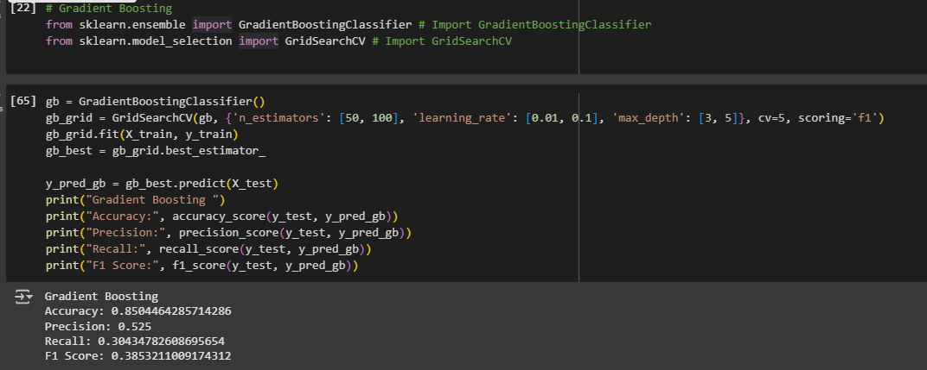
Gradent boosting –
Gradient boosting is an ensemble learning method that combines multiple weak learners to create a strong predictive model. The algorithm sequentially builds trees, with each tree correcting the errors of its predecessors.
The output shows the accuracy, precision, recall, and F1 score of the trained model, which are 0.8616, 0.6522, 0.2174, and 0.3261, respectively.

Slide 16
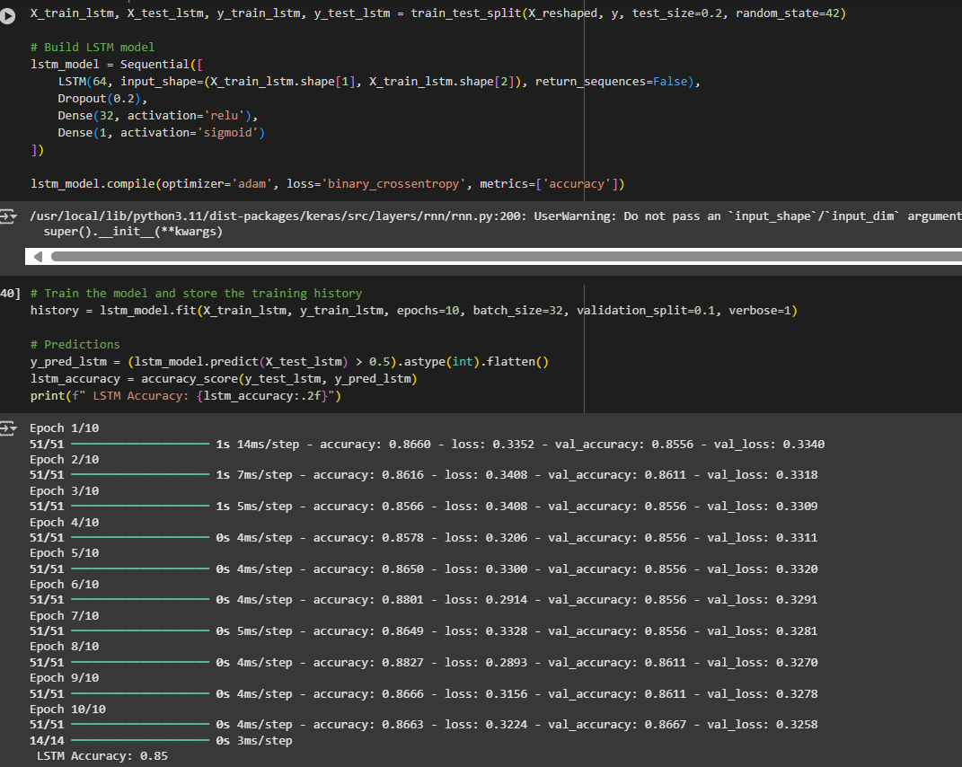
LSTM-
process of building and training an LSTM model for binary classification, commonly used in tasks like predicting customer behavior or sentiment analysis.
The LSTM (Long Short-Term Memory) model achieved an accuracy of 0.85. The training process involved 10 epochs with a batch size of 32 and a validation split of 0.1.

Slide 17
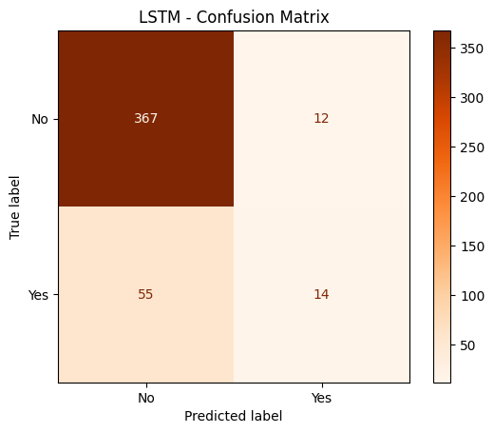
confusion matrix for an LSTM (Long Short-Term Memory) model. A confusion matrix is a table that visualizes the performance of a classification model by showing the counts of true positive, true negative, false positive, and false negative predictions.
True Negatives (TN):367 instances where the true label was "No" and the model predicted "No”.
False Positives (FP):12 instances where the true label was "No" but the model incorrectly predicted "Yes“.
False Negatives (FN):55 instances where the true label was "Yes" but the model incorrectly predicted "No”.
True Positives (TP):14 instances where the true label was "Yes" and the model predicted "Yes."

Slide 18
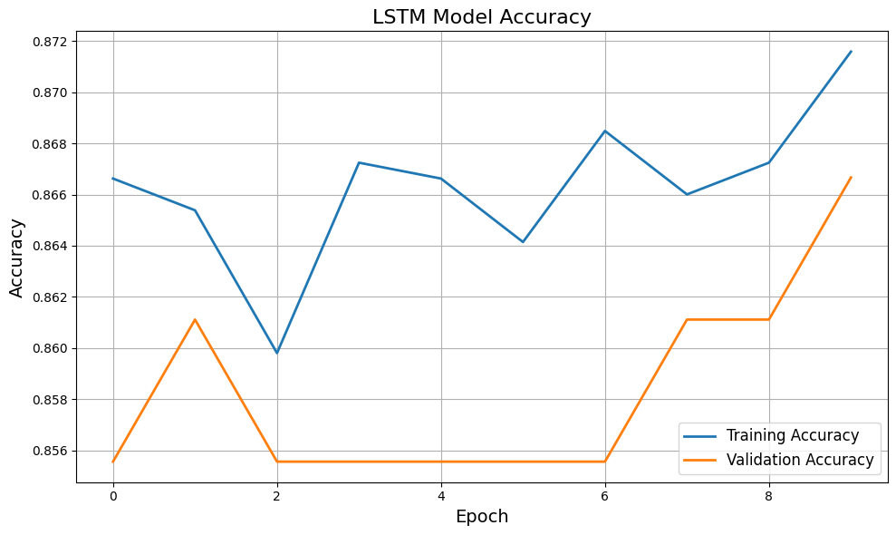
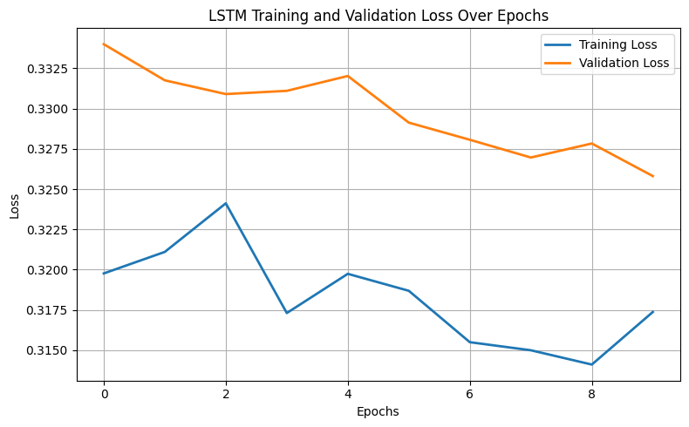
Representing the accuracy and loss of a Long Short-Term Memory (LSTM)- The graphs suggest that the LSTM model trains well on the training data but may suffer from overfitting. The model achieves high training accuracy and low training loss, but the validation accuracy plateaus and the validation loss increases after a certain number of epochs. This behavior is typical in machine learning and may require techniques like regularization, dropout, or early stopping to improve the model's generalization capability.

Slide 19
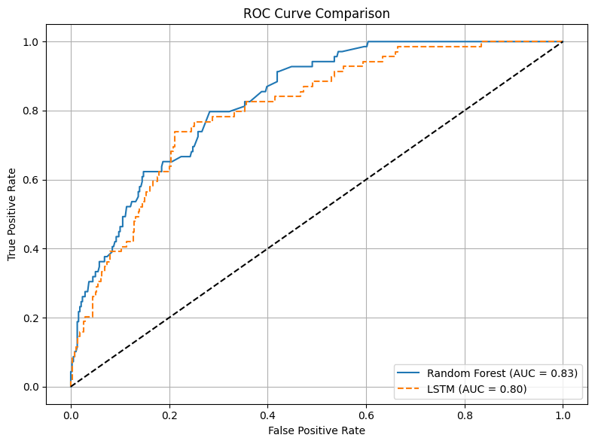
Receiver Operating Characteristic (ROC) curve comparing the performance of two machine learning models: Random Forest and LSTM (Long Short-Term Memory). The ROC curve provides a comprehensive view of the performance of the two models, allowing for informed decision-making regarding model selection and threshold optimization.
The Random Forest model shows a slightly better performance than the LSTM model, with an AUC of 0.83 compared to 0.80.
Both models perform significantly better than random chance, as their AUC values are well above 0.5.
The choice between the two models may depend on other factors such as computational cost, interpretability, and specific requirements of the application.

Slide 20
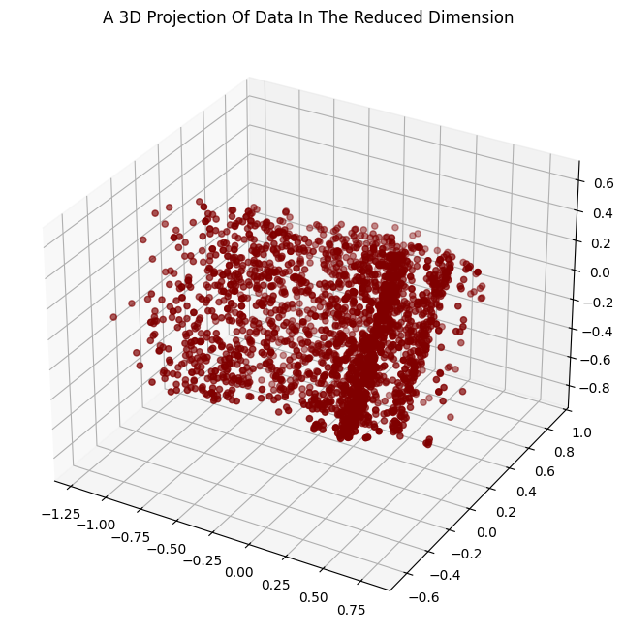
Principal Component Analysis (PCA)-
Principal Component Analysis (PCA) was used to reduce the dimensionality of the dataset while retaining as much variance as possible.
The image shows a 3D scatter plot visualizing data in a reduced dimension, likely the result of Principal Component Analysis (PCA).
The plot is titled "A 3D Projection Of Data In The Reduced Dimension" and displays data points as maroon circles scattered across three axes.
3D scatter plots are used to show the relationship between three variables.

Slide 21
Conclusion
This project successfully analyzed customer data to predict marketing campaign responses using machine learning models like Random Forest, Gradient Boosting, and LSTM. Feature engineering and exploratory analysis revealed key customer behavior patterns, emphasizing the need for personalized marketing strategies. Additionally, the application of PAC (Probably Approximately Correct) learning provided theoretical insights into model reliability and generalization, ensuring both performance and interpretability. Overall, combining predictive modeling with PAC explanations enhances decision-making, customer targeting, and long-term business value.

Slide 22
THANK YOU

